Slide 1
National and International Laws and Organizations Supporting Nuclear Security and Nonproliferation
Notes:
Introduction to Notes Section:
This notes section will include notes for further reference to the presenter as
well as voice narrations that can be utilized for the videos presented
within the Software Demonstration section. The sections are outlined in the
following order and have the respective number of slides included,
Introduction of Quantitative Assessment Methodologies, 6 slides
MAUA at the University of Texas in Austin, 31 slides
Software Demonstration, 42 slides and
References and Related Articles, 3 slides.
Each of these sections begin with a title slide, similar to the opening slide. The
sections can be discussed independently or together depending on the
presenter’s respective audience and time allotment.
Notes to the presenter will be notated as “Notes”, whereas voice narration to
videos will be notated as “Voice Narration”.
Videos for the presentation are independent recordings linked to separate files.
To play the video while viewing the slide show, a hand will appear. Click with
the hand icon active anywhere on the slide. When the video has concluded,
press the forward arrow to advance to the next slide.

Slide 2


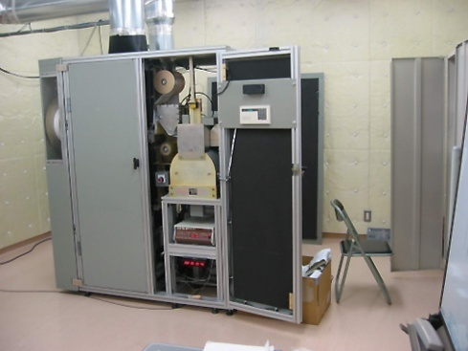
Outline
International treaties and agreements
International organizations
U.S. laws and organizations
Detection and enforcement

Slide 3
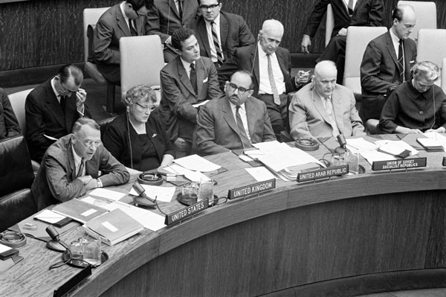
International Treaties and Agreements
Partial Test Ban Treaty 1963
Nuclear Non-Proliferation Treaty (NPT) 1968
Threshold Test Ban Treaty 1974
Comprehensive nuclear Test-Ban Treaty (CTBT)
Proposed Fissile Material Cutoff Treaty
Nuclear Weapon Free Zones
US/Russia collaborations

Slide 4
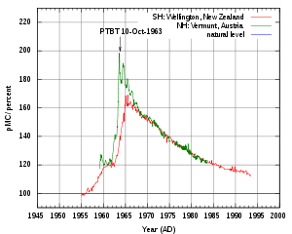
1963: Partial Test Ban Treaty
Prohibits all test detonations of nuclear weapons except underground.
It was developed in 1963 to
Slow the arms race
Stop the excessive release of nuclear fallout into the planet's atmosphere
Atmospheric ¹⁴C
http://en.wikipedia.org/wiki/Partial_Test_Ban_Treaty

Slide 5
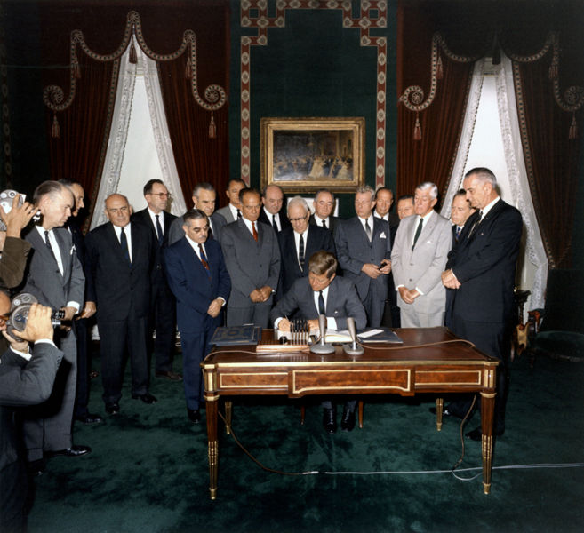
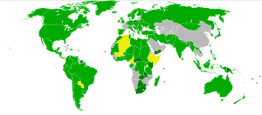
Partial Test Ban Treaty (PTBT)
The treaty was signed by the Governments of the USSR, the UK, and the USA (the "Original Parties“) at Moscow on August 5, 1963 and opened for signature by other countries.
Participation in the Partial Test Ban Treaty
Signed and ratified
Acceding or succeeding
Only signed
http://en.wikipedia.org/wiki/Partial_Test_Ban_Treaty

Slide 6
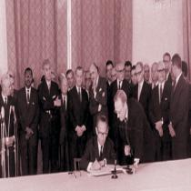
1968: Nuclear Non-Proliferation Treaty
Purpose: limit the proliferation of nuclear weapons
Opened for signature on July 1, 1968.
Text can be found at http://www.un.org/en/conf/npt/2005/npttreaty.html
http://en.wikipedia.org/wiki/Nuclear_Nonproliferation_Treaty

Slide 7
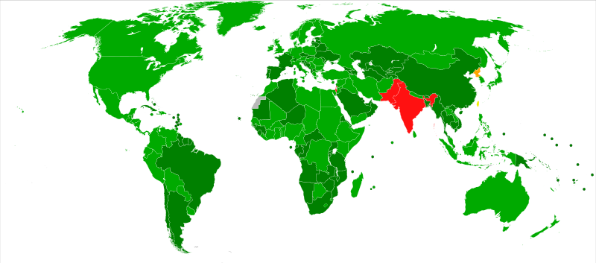
Nuclear Non-Proliferation Treaty
Participants:
Currently 189 countries party to the treaty
5 have nuclear weapons (Nuclear Weapons States – NWS) and are permanent members of the UN Security Council: the USA, Russia, the UK, China and France
Participation in the Nuclear Non-Proliferation Treaty
as of July 2008 :
Signed and ratified
Acceded or succeeded
Abiding by treaty though outside
Withdrawn
Non-signatory
http://en.wikipedia.org/wiki/Nuclear_Nonproliferation_Treaty

Slide 8
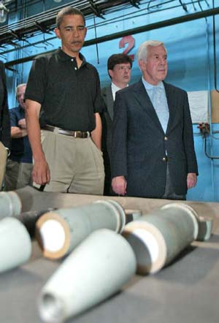

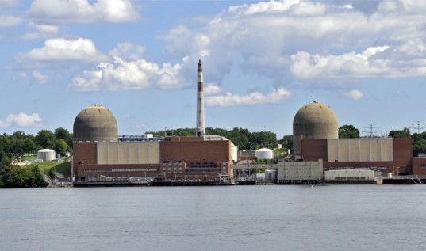
Nuclear Non-Proliferation Treaty
The NPT consists of a preamble and 11 articles.
Three objectives
Nonproliferation
Disarmament
Peaceful Use of Nuclear Energy

Slide 9
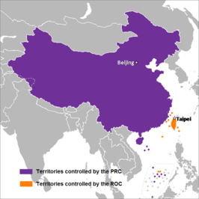
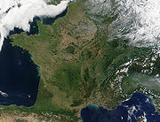
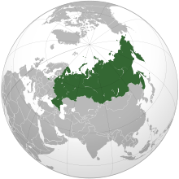
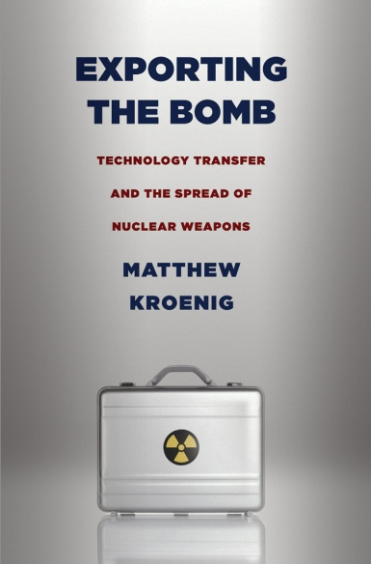
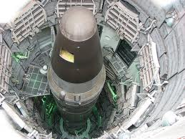
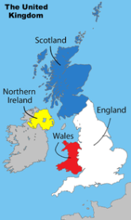
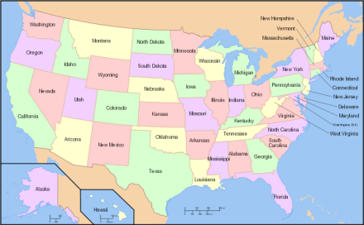
NPT: Nonproliferation
NWS
Article I - The NWS agree not to
Transfer "nuclear weapons or other nuclear explosive devices“ to non-nuclear weapon states (NNWS)
“Assist, encourage, or induce" a NNWS to acquire nuclear weapons
China
France
Russian Federation
UK
http://en.wikipedia.org/wiki/Nuclear_Nonproliferation_Treaty
USA

Slide 10
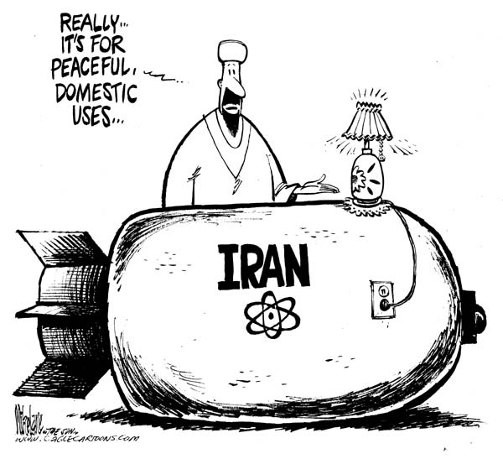
NPT: Nonproliferation
NWS
Article II - NNWS parties to the NPT agree not to
“Receive," "manufacture" or "acquire" nuclear weapons
“Seek or receive any assistance in the manufacture of nuclear weapons"
China
France
Russian Federation
UK
http://en.wikipedia.org/wiki/Nuclear_Nonproliferation_Treaty
USA

Slide 11
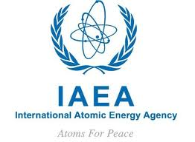
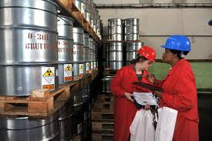
NPT: Nonproliferation
NWS
Article III - NNWS parties agree to accept safeguards by the IAEA to verify that they are not diverting nuclear energy from peaceful uses to nuclear weapons or other nuclear explosive devices
China
France
Russian Federation
UK
http://en.wikipedia.org/wiki/Nuclear_Nonproliferation_Treaty
USA

Slide 12
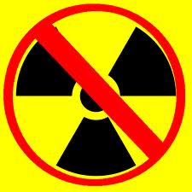

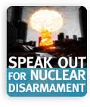
NPT: Disarmament
The wording of the NPT's Article VI imposes only a vague obligation of disarmament saying,
"Each of the Parties to the Treaty undertakes to pursue negotiations in good faith on effective measures relating to cessation of the nuclear arms race at an early date and to nuclear disarmament, and on a treaty on general and complete disarmament.“

Slide 13
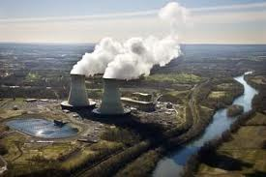
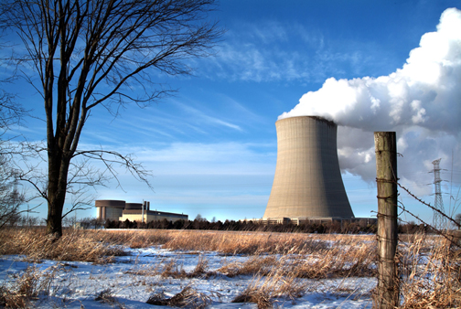
NPT: Nuclear Energy
All State Parties to the Treaty agree to full exchanges of equipment, materials and scientific and technological information for peaceful uses of nuclear energy.

Slide 14
1974: Threshold Test Ban Treaty
The Treaty on the Limitation of Underground Nuclear Weapon Tests, also known as the Threshold Test Ban Treaty (or TTBT),
Signed in July 1974 by the USA and USSR.
Establishes a nuclear "threshold," by prohibiting nuclear tests of devices having a yield >150 kt
Detailed technical data to be exchanged
Limited weapon testing to specific designated test sites to assist verification
http://en.wikipedia.org/wiki/Threshold_Test_Ban_Treaty

Slide 15
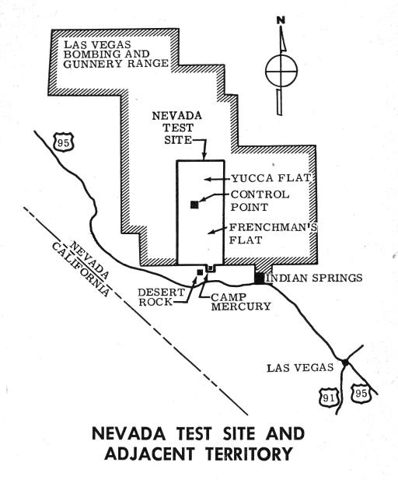
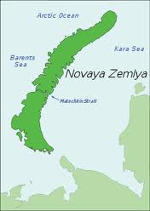
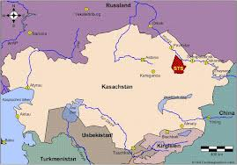
TTBT Specified Test Sites
USA: the Nevada Test Site
USSR:
the Northern Test Site (Novaya Zemlya) and
the Semipalatinsk Test Site

Slide 16
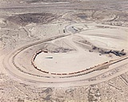
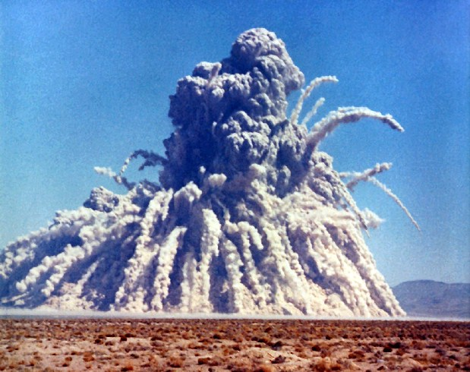
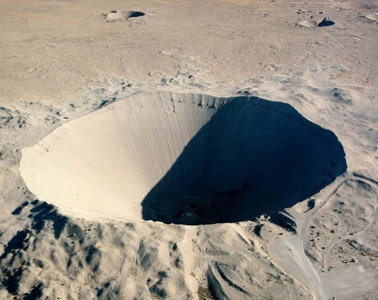
1976: Peaceful Nuclear Explosion Treaty (PNET)
Signed in April 1976 by the USA and USSR
Governs all nuclear explosions carried out at locations outside the weapons test sites specified under the Threshold Test Ban Treaty (TTBT).
The United States carried out
over 20 PNE's at the NTS.
The Sedan explosion, 6 July 1962
at NTS was carried out as part of
Operation Storax - a PNE project.
The Sedan explosion created the
largest man-made crater in the world.

Slide 17
Peaceful Nuclear Explosion Treaty (PNET)
In the PNE Treaty the signatories agreed not to carry out:
Individual nuclear explosions having a yield > 150 kt
Group explosions having an aggregate yield >1,500 kt
Group explosions having an aggregate yield > 150 kt unless the individual explosions in the group could be identified and measured by agreed verification procedures.
The parties also reaffirmed their obligations to comply fully with the Partial Test Ban Treaty of 1963.

Slide 18
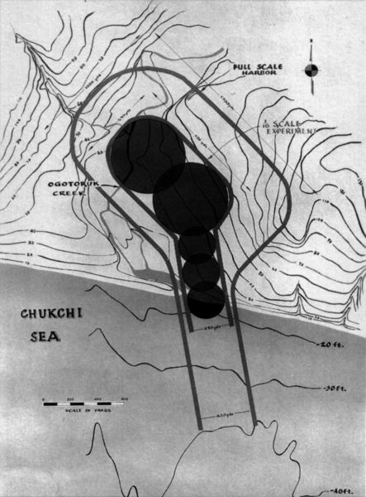
Peaceful Nuclear Explosions Concept
PNEs had a variety of objectives:
deep seismic sounding,
creating underground storage cavities,
helping to extract gas and oil,
extinguishing burning gas or oil wells,
creating reservoirs,
constructing harbors and canals,
destroying chemical weapons, and
spacecraft propulsion.
Plans to use five thermonuclear explosions to create an artificial harbor at Cape Thompson, Alaska, for Project Chariot in 1958. It was eventually cancelled amid controversy and protest.

Slide 19
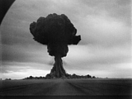
PNEs
Numbers
USA : 20
USSR : 124 (between 1965 & 1988)
As the environmental and health effects of nuclear fallout became apparent, most countries scrapped plans for such projects.
The 1996 CTBT bans ALL nuclear explosions, peaceful or not.
Semipalatinsk was also
used for PNEs.
http://www.ctbto.org/nuclear-testing/history-of-nuclear-testing/peaceful-nuclear-explosions/

Slide 20
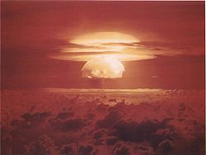
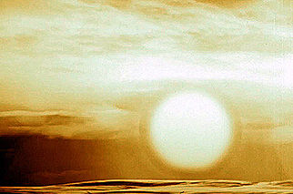
1996: Comprehensive Nuclear Test-Ban Treaty (CTBT)
Bans ALL nuclear explosions in all environments, for military or civilian purposes.
Adopted by the UN General Assembly on 10 Sept.1996, but it has not yet entered into force.
183 countries have signed it.
166 countries have ratified it.
Comes into effect when ratified by a select group of 44 countries.
Note: US and several other NWS have not yet ratified it.
1954 Castle Bravo mushroom cloud
The 1961 Tsar Bomba's massive fireball, measuring 8 kilometres (5.0 mi) in diameter touched the ground.

Slide 21
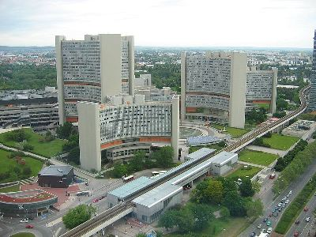
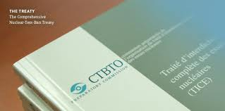
Comprehensive Nuclear Test-Ban Treaty (CTBT)
Supported by the CTBT Organization in Vienna, Austria. (addressed later)
http://www.youtube.com/watch?v=8ziAUe3eQDI 4:29

Slide 22
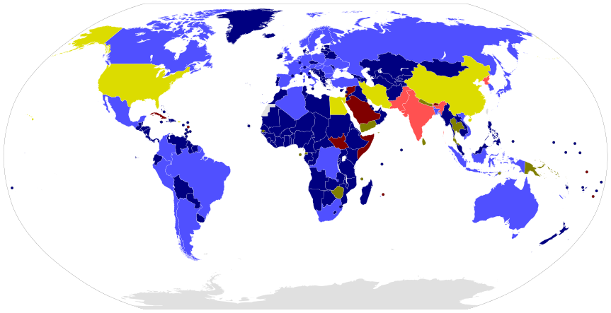
CTBT Participation
Annex 2, signed and ratified Not Annex 2, signed and ratified
Annex 2, only signed Not Annex 2, only signed
Annex 2, non-signatory Not Annex 2, non-signatory
From http://en.wikipedia.org/wiki/File:CTBT_Participation.svg

Slide 23
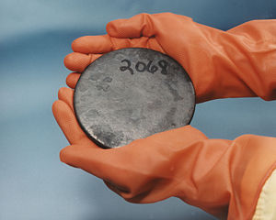
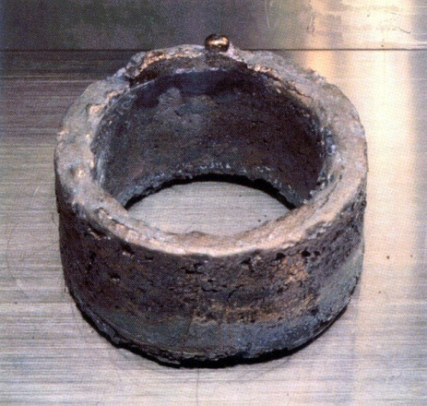
Proposed Fissile Material Cutoff Treaty
The Fissile Material Cutoff Treaty (also FISSBAN or FMCT) is a proposed international treaty to prohibit the further production of weapons-grade U and Pu.
Talks on this treaty began in the UN Conference on Disarmament in 1993.
In 2004, the US announced that they opposed the inclusion of a verification mechanism in the treaty on the grounds that compliance with the treaty could not be conclusively determined by a system of international verification.
Uranium disk
Weapons-grade electrorefined plutonium
http://en.wikipedia.org/wiki/Fissile_Material_Cut-off_Treaty

Slide 24
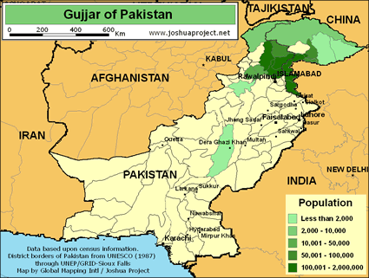
FMCT (cont.)
On April 5, 2009, U.S. President Barack Obama reversed the U.S. position on verification and proposed to negotiate "a new treaty that verifiably ends the production of fissile materials intended for use in state nuclear weapons."
On May 29, 2009, the Conference on Disarmament (CD) agreed to establish an FMCT negotiating committee.
However, Pakistan has repeatedly blocked the CD from implementing its agreed program of work, despite severe pressure from the major nuclear powers.
http://en.wikipedia.org/wiki/Fissile_Material_Cut-off_Treaty

Slide 25
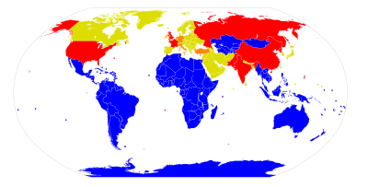
Nuclear Weapon Free Zones
A NWFZ is defined by the UN as an agreement which a group of states has freely established by treaty or convention, that bans the use, development, or deployment of nuclear weapons in a given area.
has mechanisms of verification and control to enforce its obligations
is recognized as such by the General Assembly of the UN.
Nuclear-Weapon-Free Zones NW states Nuclear sharing NPT only
http://en.wikipedia.org/wiki/NWFZ

Slide 26

Joint Comprehensive Plan of Action (The Iran Nuclear Deal)
Agreement between Iran and the P5+1 States signed in 2015.
Places limits on Iran’s nuclear energy activities in exchange for economic sanctions relief.
Limits enrichment to 3.67% and eliminates most enriched inventory.
Design changes to the Arak Reactor.
Spent fuel must be exported.
Extensive IAEA inspections to verify compliance.
Iranian ”Breakout Time” increased from 2 months to 1 year.
http://en.wikipedia.org/wiki/NWFZ

Slide 27
The Iran Nuclear Deal: 2018 Update
On May 8th, the US president said of the JCPOA:
“horrible, one-sided deal that should have never, ever been made”
“very weak limits on the regime’s nuclear activity and no limits at all on…sinister activities in Syria, Yemen and other places all around the world”.
“sunset clauses…totally unacceptable”
Did not address ballistic missiles
Did not have enough inspection and verification
The US will being reinstating the “highest level of economic sanctions” on Iran.
US vowed to re-negotiate a new deal to address these concerns.
Iran has threatened to step up enrichment and restart other nuclear activities.

Slide 28
Was Iran complying with the deal?
IAEA inspectors have certified 10 time that Iran is fulfilling its end of the deal.
However, Iran has:
Twice exceeded its heavy-water production cap.
Denied IAEA inspectors access to military sites
Carried out ballistic missile tests in violation

Slide 29
Simplification of historical Iranian nonproliferation politics
Iran agrees:
receives economic benefit,
secretly continues developing ☢️
Iran develops ☢️
P5+1 states grow concerned
Nonproliferation agreements are proposed
Iran disagrees:
Receives economic sanctions,
aggressively develops ☢️
Iran gains ☢️
time
International relationships worsen

Slide 30
US/Russia Collaborations
Partial or Limited Test Ban Treaty (PTBT/LTBT): 1963. Also put forth by Kennedy; banned nuclear tests in the atmosphere, underwater and in space. However, neither France nor China (both Nuclear Weapon States) signed.
Nuclear Non-Proliferation Treaty (NPT): 1968. Established the US, USSR, UK, France, and China as five "Nuclear-Weapon States". Non-Nuclear Weapon states were prohibited from possessing, manufacturing, or acquiring nuclear weapons or other nuclear explosive devices. All 187 signatories were committed to the goal of (eventual) nuclear disarmament.
http://en.wikipedia.org/wiki/SALT_I

Slide 31
US/Russia Collaborations
Anti-Ballistic Missile Treaty (ABM): 1972. Entered into between the U.S. and USSR to limit the anti-ballistic missile (ABM) systems used in defending areas against missile-delivered nuclear weapons; ended by the US in 2002.
Strategic Arms Limitation Treaties I & II (SALT I & II): 1972 / 1979. Limited the growth of US and Soviet missile arsenals.
Prevention of Nuclear War Agreement: 1973. Committed the US and USSR to consult with one another during conditions of nuclear confrontation.
Threshold Test Ban Treaty: 1974. Capped nuclear tests at 150 kt.
http://en.wikipedia.org/wiki/SALT_I

Slide 32
US/Russia Collaborations (cont.)
Intermediate-Range Nuclear Forces Treaty (INF): 1987. Eliminated conventional and nuclear ballistic missiles with ranges less than 5,500 km.
Strategic Arms Reductions Treaty I (START I): 1991. This was signed by George H. W. Bush and Mikhail Gorbachev; reduced the numbers of U.S. and Soviet long-range missiles and nuclear warheads from 10,000 per side to 6,000 per side.
http://en.wikipedia.org/wiki/SALT_I
http://en.wikipedia.org/wiki/HEU_Agreement

Slide 33
US/Russia Collaborations (cont.)
U.S.-Russian Federation Highly Enriched Uranium (HEU) Purchase Agreement: 1993. Over a 20-year period, the Russian Federation is required to provide LEU originated from destruction of dismantled nuclear weapons that is then purchased by electrical utilities as fuel for electric generating nuclear reactors.
Strategic Arms Reductions Treaty II (START II): 1993. Goal: to reduce the numbers of U.S. and Russian long-range missiles and nuclear warheads from 6,000 per side to 3,500-3,000 per side. Never came into effect.
http://en.wikipedia.org/wiki/SALT_I
http://en.wikipedia.org/wiki/HEU_Agreement

Slide 34
US/Russia Collaborations
1994
Mutual Detargeting Treaty (MDT): U.S. and Russian missiles no longer automatically target the other country; nuclear forces are no longer operated in a manner that presumes that the two nations are adversaries.
To prevent terrorists from gaining access, NNSA begins work securing nuclear and radiological material in Russia and the former Soviet Union by performing security upgrades at several Russian nuclear facilities.

Slide 35
US/Russia Collaborations
Comprehensive Test Ban Treaty (CTBT): 1996. Prohibits all nuclear test explosions in all environments. Facilitated US/Russia discussions and technology sharing regarding monitoring. Has not come into effect.
Strategic Offensive Reductions Treaty (SORT/Moscow Treaty (2002)):
Established bilateral strategic nuclear arms reductions and a new “strategic nuclear framework.”
Invited all countries to adopt non-proliferation principles aimed at preventing terrorists, or those that harbored them, from acquiring or developing all types of WMD's and related materials, equipment, and technology.

Slide 36
US/Russia Collaborations
New START Treaty (2009)
Superseded SORT.
New, lower limits on nuclear weapons.
1,550 active warheads each.
700 active delivery systems each.
Ratified by both countries and is in effect.

Slide 37
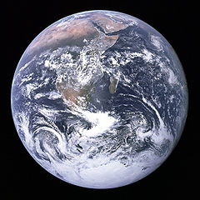
International Organizations
International Atomic Energy Agency (IAEA)
Convention on the Physical Protection of Nuclear Materials (CPPNM)
CTBT Organization (CTBTO)
Famous "Blue Marble" photograph of Earth, taken from Apollo 17

Slide 38

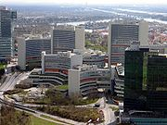
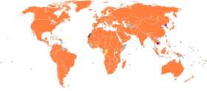
International Atomic Energy Agency (IAEA)
Established in 1957
Headquarters in Vienna, Austria
Serves as an intergovernmental forum for scientific and technical cooperation in the peaceful use of nuclear technology worldwide.
Encourages development of peaceful applications of nuclear science & technology,
Provides international safeguards and verification against misuse of nuclear technology, and
Facilitates application of safety and security measures.
IAEA Flag
IAEA Headquarters
IAEA Member States
http://en.wikipedia.org/wiki/IAEA

Slide 39
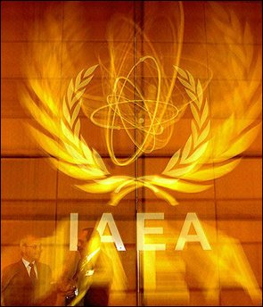

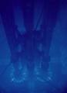
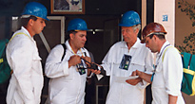
IAEA Departments
Nuclear Applications - helps countries use nuclear and isotopic techniques to promote sustainable development objectives in agriculture, human health, water resource management, marine environment and industrial applications.
Nuclear Energy - fosters the efficient and safe use of nuclear power by supporting nuclear programs around the world, catalyzing innovation and building capability in energy planning, analysis, and nuclear information and knowledge.
http://www.iaea.org/OurWork/index.html

Slide 40
IAEA Departments
Safety and Security - works to provide a strong, sustainable and visible global nuclear safety and security framework, protecting people and the environment from the harmful effects of ionizing radiation.
Safeguards - carries out the duties and responsibilities of the IAEA as the world’s nuclear inspectorate, performing an indispensable role in global efforts to stop the spread of nuclear weapons.
Technical Cooperation - helps countries to improve their scientific and technological capabilities in the peaceful applications of nuclear technology, thus contributing to sustainable development.
http://www.iaea.org/OurWork/index.html

Slide 41
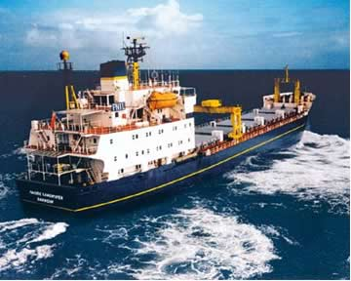
Convention on the Physical Protection of Nuclear Materials (CPPNM)
Adopted on 26 October 1979 in Vienna, Austria.
Entered into force on 8 February 1987 and is
deposited with the IAEA.
In July 2005 a diplomatic conference was
convened to amend the CPPNM and strengthen
its provisions.
Transportation of MOX fuel
http://en.wikipedia.org/wiki/Convention_on_the_Physical_Protection_of_Nuclear_Material

Slide 42
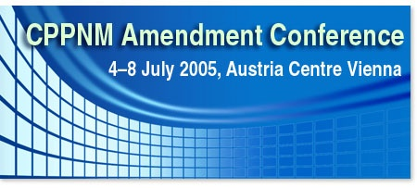
Convention on the Physical Protection of Nuclear Materials (CPPNM)
Provides for certain levels of physical protection during international transport of nuclear material.
Establishes a general framework for cooperation among states in the protection, recovery, and return of stolen nuclear material.
Lists certain serious offenses involving nuclear material which state parties are to make punishable and for which offenders shall be subject to a system of extradition or submission for prosecution.
http://en.wikipedia.org/wiki/Convention_on_the_Physical_Protection_of_Nuclear_Material

Slide 43
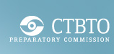
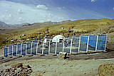



CTBTO
The main tasks of the CTBTO are in establishing and provisionally operating the 337 facility International Monitoring System (IMS), including its International Data Centre (IDC) and Global Communications Infrastructure (GCI).
IMS includes seismic, hydroacoustic, infrasound, and radionuclide stations around the world.
The Commission is also tasked with the development of operational manuals, including a manual to guide conduct of on-site inspections (OSI).
Seismic station at Tehran, Iran
Radionuclide station at
Yellowknife, Canada
Infrasound station at
Easter Island, Chile
Hydrophone nodes ready for
deployment at Wake Island.

Slide 44




U.S. Laws and Organizations
Department of Energy (DOE)
National Nuclear Security Agency (NNSA)
Office of Secure Transportation (OST)
Nuclear Regulatory Commission (NRC)
Pertinent Code of Federal Regulations (10CFR)
Department of Defense (DOD)
National Data Center (NDC) at the Air Force Technical Applications Center (AFTAC)
Department of Homeland Security (DHS)

Slide 45

Department of Energy (DOE)
The US DOE is a Cabinet-level dept. of the US govt. concerned with US’s policies regarding energy and safety in handling nuclear material.
Sponsors more basic and applied scientific research than any other US federal agency - most of this is funded through national labs
James Forrestal headquarters complex in Washington, D.C.
http://en.wikipedia.org/wiki/United_States_Department_of_Energy

Slide 46



Department of Energy (DOE)
DOE responsibilities include the nation's
nuclear weapons program,
nuclear reactor production for the United States Navy,
energy conservation,
energy-related research,
radioactive waste disposal,
and domestic energy production.
http://en.wikipedia.org/wiki/United_States_Department_of_Energy

Slide 47



National Nuclear Security Administration (NNSA)
Formed in 1999 with 4 missions:
To manage the U.S. nuclear weapons stockpile.
To reduce global danger from weapons of mass destruction and to promote international nuclear safety and nonproliferation.
To provide the US Navy with safe, militarily effective nuclear propulsion plants and to ensure the safe and reliable operation of those plants.
To support US leadership in science and technology.
http://en.wikipedia.org/wiki/NNSA

Slide 48

National Nuclear Security Administration (NNSA)
The agency works in more than 130 countries to recover nuclear materials.
In its 12-year history it has collected 20,600 dangerous sources of radiation.
http://en.wikipedia.org/wiki/NNSA

Slide 49


Office of Secure Transportation (OST)
Provides safe and secure transportation of nuclear weapons and components and special nuclear materials, and conducts other missions supporting the national security of the USA.
Shipments are transported in specially designed equipment and are escorted by armed Federal Agents (Nuclear Material Couriers).
DOE Safeguards Transporter
http://en.wikipedia.org/wiki/United_States_Department_of_Energy

Slide 50
Office of Secure Transportation (OST)
Operates a nationwide communications system located in Albuquerque, NM - the Transportation and Emergency Control Center (TECC)
monitors the status and location of shipments and maintains real-time communications 24-hours a day with every convoy
DOE Safeguards Transporter
http://en.wikipedia.org/wiki/United_States_Department_of_Energy

Slide 51
Nuclear Regulatory Commission
Established by the Energy Reorganization Act in 1974, and first opened January 19, 1975.
The NRC's regulatory mission covers three main areas:
Reactors - Commercial reactors for generating electric power and research and test reactors used for research, testing, and training
Materials - Uses of nuclear materials in medical, industrial, and academic settings and facilities that produce nuclear fuel
Waste - Transportation, storage, and disposal of nuclear materials and waste, and decommissioning of nuclear facilities from service
http://en.wikipedia.org/wiki/Nuclear_Regulatory_Commission

Slide 52

NRC Regions
Four regions oversee the operation of 104 power-producing reactors, and 36 non-power-producing reactors. This oversight is done on several levels:
Each power-producing reactor site has Resident Inspectors, who monitor day to day operations
Numerous special inspection teams, with many different specialties, routinely conduct inspections at each site
Whistleblower reports are investigated by special teams
http://en.wikipedia.org/wiki/Nuclear_Regulatory_Commission

Slide 53

US Laws: Code of Federal Regulations (10CFR)
The CFRs is the codification of the general and permanent rules and regulations published in the Federal Register by the executive departments and agencies of the Federal Govt of the US.
The regulations are treated by the courts as being as legally binding as statutory law, with provisions.
Title 10: Energy
Chapter 1: Requirements for persons and organizations who receive a license from NRC to use nuclear materials or operate nuclear facilities

Slide 54
Selected Parts of 10CFR
10CFR20 Standards for protection against radiation
10CFR35 Medical use of byproduct material
10CFR60 Disposal of high-level radioactive wastes in geologic repositories
10CFR 75 Safeguards on nuclear material-implementation of US/IAEA agreement
10CFR76 Certification of gaseous diffusion plants
10CFR110 Export and import of nuclear equipment and material
http://www.nrc.gov/reading-rm/doc-collections/cfr/

Slide 55

Department of Defense (DOD)
Charged with coordinating and supervising all agencies and functions of the govt. relating directly to national security and the military.
The organization and functions of the DOD are set forth in Title 10 of the US Code.
The Defense Threat Reduction Agency (DTRA) within the DoD funds research and programs that support nuclear security and nonproliferation.

Slide 56

National Data Center (NDC) at the Air Force Technical Applications Center (AFTAC)
AFTAC is home to the US NDC.
AFTAC provides national authorities technical measurements to monitor nuclear treaty compliance and develops advanced proliferation monitoring technologies to preserve national security.
AFTAC operates and maintains a global network of nuclear event detection sensors called the U.S. Atomic Energy Detection System (USAEDS) and perform event analysis.
http://www.tt.aftac.gov/WRT/USIMS/Index.html

Slide 57

National Data Center (NDC) at the Air Force Technical Applications Center (AFTAC)
AFTAC's nuclear event detection mission is directly linked to its nuclear treaty-monitoring mission.
1963 Limited Test Ban Treaty
1974 Threshold Test Ban Treaty of 1974
1976 Peaceful Nuclear Explosion Treaty of 1976
Nuclear-Test-Ban Treaty (CTBT).
http://www.tt.aftac.gov/WRT/USIMS/Index.html

Slide 58

Department of Homeland Security
A cabinet department of the US fed. govt. with the primary responsibilities of protecting US territory from terrorist attacks and responding to natural disasters.
http://en.wikipedia.org/wiki/United_States_Department_of_Homeland_Security

Slide 59
Department of Homeland Security Agencies
United States Citizenship and Immigration Services
U.S. Customs and Border Protection
U.S. Immigration and Customs Enforcement
Transportation Security Administration (TSA) - Responsible for aviation, land, and water transportation security
United States Coast Guard (USCG) – maritime security, etc.
United States Secret Service
Federal Emergency Management Agency (FEMA) – Disaster preparedness, response, and recovery
http://en.wikipedia.org/wiki/United_States_Department_of_Homeland_Security

Slide 60
Department of Homeland Security
Other components include (selective list)
Domestic Nuclear Detection Office – Develop nuclear threat detection capabilities at all levels of government and in the private sector
National Communications System
Directorate for Science and Technology – Research and development
Office of Intelligence and Analysis – Identify and assess threats based on intelligence from various agencies
Office of Operations Coordination – Monitor domestic security situation on a daily basis, coordinate activities with state and local authorities and private sector infrastructure
http://en.wikipedia.org/wiki/United_States_Department_of_Homeland_Security

Slide 61



Nuclear Test Detection and Enforcement
Air sampling via fly-overs
Remote sensing
Onsite inspections
Ramifications of positive detection

Slide 62

Detection: Air Sampling Via Fly-Overs
This method of nuclear test detection has been used for 60+ years. It entails:
Flying an airplane near a test site.
The airplane is equipped with air sampling equipment.
The air samples are then put on a detector to measure radioactivity.

Slide 63


Detection: Remote Sensing
CTBTO global detection system
National efforts
Satellite images
Detectors
Data analysis/Software

Slide 64


CTBTO Global Detection System
Part of the CTBT verification regime includes the International Monitoring System (IMS).
The IMS includes stations worldwide that detect
Seismic waves
Hydroacoustic waves
Infrasound waves
Atmospheric radioactivity
1998 Pakistan Nuclear Weapon Tests

Slide 65


IMS Network
From http://www.ctbto.org/map/

Slide 66


International Data Center (IDC)
IMS stations send their data to the IDC at CTBTO headquarters in Vienna, Austria via the Global Communications Infrastructure (GCI).
The IDC analyzes the data, and creates data products to send to the treaty signatories.

Slide 67

National Efforts
AFTAC USAEDS (previously mentioned)
http://www.tt.aftac.gov/WRT/USIMS/Index.html

Slide 68

Satellite Images
Analysis of images from satellites can provide evidence of testing and facility usage (e.g., U enrichment).
A satellite image taken in January 2012 shows the Yongbyon nuclear reactor in North Korea. Photo: Reuters/DigitalGlobe

Slide 69






Detectors
http://www.ctbto.org/verification-regime/featured-stations/
Seismic
Hydroacoustic
Infrasound
Radionuclide
Aerosol
Gas
Construction of IMS primary seismic station PS12, Hailar, China.
IMS Primary seismic station PS41, Chiang Mai, Thailand.
Hydroacoustic stations are the most complex and expensive in construction and maintenance.
Hydrophone nodes awaiting deployment.
IMS RN40 is located about 3 metres above sea level on the southern shore of Kuwait Bay.
An automatic station of the RASA type - a Radionuclide Aerosol Sampler and Analyzer in Takasaki, Japan.
Infrasound array at Qaanaaq, Greenland

Slide 70



Seismic and Hydrosound Data
27 Jan 1996
time= 21:30
lat= 22.30 S
lon=138.8W
mb= 5.1
Nuclear
Explosion
PSUR0/sp
60/198
Filtered 3-6 Hz
TXAR/cb
61/217
Filtered 1-3 Hz
2 minutes
5 Jan 1996
time= 23:28
lat= 15.7 S
lon=177.7 W
mb=4.6
Pacific
Earthquake
PSUR0/sp
70/234
Filtered 3-6 Hz
TXAR/cb
81/247
Filtered 1-3 Hz
Pt Sur
Texas Array
2 minutes
x
x
Earthquake
Explosion

Slide 71


Infrasound Data
Nov 19, 1997
Yield: 10 tons
Signal to Noise Ratio: 5
Distance: 545 km
Surface Explosion, New Mexico
TXI02/sd
White Sands
Missile Range
TXI03/sd
TXIAR
TXI04/sd

Slide 72


Radionuclide Monitoring Stations
Particulate &
Noble Gas Sampling
Data Acquisition
Local Weather, Dose, State of Health (SOH)
Security, Safety, Environment
The SAUNA detection system was developed in Sweden.

Slide 73


Radionuclide Detection – Sample Spectra
Pb-212
Be-7
K-40
Tl-208
Te-132
Ba-140
Zr-97
Sr-91
La-140
Tc-99m
I-133
Natural radioactivity
measured in Kuwait
Fission spectrum produced to simulate a nuclear explosion after two days of decay

Slide 74

Atmospheric Transport
Atmospheric transport data supports
Computations of Fields of Regard and
Cross-referencing with information from seismic, hydroacoustic, and infrasound techniques
Tip-off
24-hr FORs

Slide 75
Data Analysis/Software
Data Acquisition (e.g., a RASA)
Collection Rate>= 500 m³/hr
Filter Efficiency >= 80% @ 0.2 um
Energy Range 50-2000 keV
HPGe Detector >= 40% Efficiency
Sensitivity for Ba-140 - 0.5 Bq
Import
All Messages
Received Via E-mail
Auxiliary Data
Spectral Data
State of Health Data
Automated Processing
Calibrations
Peak Search
Peak ID
MDC’s
Categorization
Interactive Analysis
RAMS Software
Priority to Spectra with
Manmade Nuclides
Check Reasonableness
of Data
Perform Detailed Peak
Analysis
Archiving
Store All Input Files,
Automated and Interactive
Analysis Results (2GB/year)
Export
WWW Browsing
Subscriptions
E-mail Requests

Slide 76
IDC Multi-Sensor Data Fusion Products
1
2
4
6
10
1
2
1
2
hr
hr
hr
hr
hr
dy
dy
wk
wk
Seismic
Seismic
Reviewed
Reviewed
Hydroacoustic
Seismic
Seismic
Hydroacoustic
Hydroacoustic
Hydroacoustic
Infrasound &
& Infrasound
Radionuclide
Infrasound
Products
Products
Infrasound
Radionuclide
Reviewed Radionuclide Products
Radionuclide
1
2
4
6
10
1
2
1
2
100
hr
hr
hr
hr
hr
dy
dy
wk
wk
Time after Event Occurrence
Automated primary signal detection
Automated association & event location
Automated auxiliary signal detection
Reviewed association & event location
Automated, event-focused signal detection

Slide 77

Detection: Onsite Inspections
Once a reasonable detection of a nuclear test has been made, treaty signatories can request an onsite inspection be performed by the IAEA.
This process is, of course, dependent on the willingness of the country being accused of testing a nuclear weapon. Also, the CTBT treaty must be entered into force.
Most onsite sampling is for detecting radionuclide signatures indicative of a nuclear weapons test.
http://www.ctbto.org/verification-regime/on-site-inspection/the-final-verification-measure/page-1/

Slide 78


First Responders
What happens in the event of a US civil nuclear terrorist event?
Organizations involved
Planning
Actions
NATO launches a course in the field of chemical, biological, radiological, and nuclear (CBRN) first response in Kuopio, Finland
A disaster response exercise held in Sirava, Slovakia, as part of a NATO PfP civil emergency planning workshop.

Slide 79


Response Management
The Federal response to any nuclear/radiological incident shall be coordinated with the State, tribal, and local government or the Federal agencies having jurisdiction over the area affected by the incident.

Slide 80
National Response Framework (NRF)
FEMA is responsible for maintaining and updating the NRF.
The NRF presents the guiding principles that enable all response partners to prepare for and provide a unified national response to disasters and emergencies.
The Nuclear/Radiological Incident Annex (NRIA) to the NRF describes the policies, situations, concepts of operations, and responsibilities of the Federal departments and agencies governing the immediate response and short-term recovery activities for incidents involving release of radioactive materials to address the consequences of the event.
Incidents will be managed at the lowest possible level; as incidents change in size, scope, and complexity, the response will adapt to meet requirements, as described in the NRF.

Slide 81






Organizations Involved
Coordinating Agencies: coordinating agencies provide the leadership, expertise, and authorities to implement critical and specific nuclear/radiological aspects of the response, and facilitate nuclear/radiological aspects of the response in accordance with those authorities and capabilities.
Department of Defense
Department of Energy
Department of Homeland Security
Environmental Protection Agency
National Aeronautics and Space Administration
Nuclear Regulatory Commission
Nuclear/Radiological Incident Annex

Slide 82

Cooperating Agencies
Cooperating agencies include other Federal agencies that provide additional technical and resource support specific to nuclear/radiological incidents to DHS and the coordinating agencies.
Department of Agriculture, Department of Commerce, Department of Defense, Department of Energy, Department of Health and Human Services, Department of Homeland Security, Department of the Interior, Department of Justice, Department of Labor, Department of State, Department of Transportation, Department of Veterans Affairs, Environmental Protection Agency, Nuclear Regulatory Commission
Nuclear/Radiological Incident Annex

Slide 83

Planning
Federal Radiological Preparedness Coordinating Committee (FRPCC) is responsible for maintaining and updating the Nuclear/Radiological Incident Annex (NRIA).
Regional Assistance Committees (RACs) in the DHS/FEMA regions serve as the primary coordinating structures at the Federal regional level.
States send representatives to RAC meetings and participate in regional exercise and training activities.
The RACs also assist in providing technical assistance to State and local governments in evaluating radiological plans and exercises.
Nuclear/Radiological Incident Annex

Slide 84
Actions
Response actions will depend on the facilities or materials involved in the incident, e.g.,
DHS is responsible for coordinating the response to a deliberate attack involving nuclear/radiological facilities or materials, including Radiological Dispersion Devices (RDDs) or Improvised Nuclear Devices (INDs).
Note: Radiological incidents may not be immediately recognized as such until the radioactive material is detected or the health effects of radiation exposure are manifested.
Local emergency organizations are usually first to respond and make this determination.
Once this determination is made, organizations on the state and federal level can respond according to their plans.
Nuclear/Radiological Incident Annex

Slide 85

NNSA’s Office of Emergency Operations
US govt’s primary capability for radiological and nuclear emergency response and for providing security to the nation from the threat of nuclear terrorism
Designed to serve as a last line of defense in the event of a nuclear terrorist incident or other types of radiological accident
Focuses on the following key areas:
Radiological search – NNSA deploys teams to look for and identify radiological material.
Render safe – This is a specialized activity of making sure a nuclear device is safe if such a device is found.
Consequence management – This is the characterization of the spread of radiological material if some type of terrorist event or natural occurring event or accident
From http://nnsa.energy.gov/aboutus/ourprograms/emergencyoperationscounterterrorism

Slide 86
The End
Thank you!

